Slide 1


SocialBuzz Data Analysis Project
Notes:
Presented By: Louay FaraJ
Role: Data Analyst
Date: November 29, 2024

Slide 2


Today's agenda
Project recap
Problem
The Analytics team
Process
Insights
Summary

Slide 3

Analyze content performance by identifying the top 5 categories based on aggregate popularity.
Audit big data practices to enhance scalability and efficiency.
Provide actionable insights for smoother IPO planning.
Project Recap

Slide 4

Problem
Notes:
SocialBuzz faces challenges due to its rapid growth and massive data scale:
Data Overload: Managing over 100,000 daily unstructured content posts and 500M monthly active users creates significant data processing and scalability issues.
Lack of Expertise: While their technical team is skilled, they lack the resources and experience to handle scaling effectively and implement best practices for big data management.
IPO Preparation: SocialBuzz plans to go public next year and requires guidance on data-driven strategies to ensure a successful IPO.
Content Analysis: Identifying top-performing content categories is critical for improving user engagement and demonstrating the platform's value to stakeholders.

Slide 5



Mae Mulligan
Project Lead
The Analytics team
Marcus Rompton
Senior Principal
Andrew Fleming
Chief Technology Architect

Slide 6
Process
1
Data Extraction
2
Data Cleaning & Preparation
3
Data Analysis
4
Visualization
5
Documentation & Recommendations
Notes:
Data Extraction
Extract relevant data from SocialBuzz’s databases using SQL.
Focus on merging the Content, Reaction, and ReactionTypes tables to create a unified dataset for analysis.
Data Cleaning and Preparation
Handle missing or inconsistent data.
Load cleaned data into Accenture's sandbox database for further analysis.
Data Analysis
Calculate the aggregate popularity of content categories based on reaction scores.
Perform sentiment analysis (positive, neutral, negative) to categorize audience reactions.
Visualization
Create visualizations such as bar charts, scatter plots, and pie charts using Tableau to present findings and trends.
Documentation and Recommendations
Document all processes and insights.
Provide IPO guidance and recommendations for improving SocialBuzz’s data practices.

Slide 7

Insights
16
Unique Categories
70%
High audience satisfaction
May 2021
Most active
Month
Notes:
Top Performing Categories
Animals dominated the content categories with the highest score of 11,958, followed by Food (6,568) and Healthy Eating (6,105).
These categories drive the most engagement and should be prioritized for content strategies.
Sentiment Breakdown
The majority of user reactions (83.83%) are positive, indicating overall satisfaction with the content.
Neutral reactions (10.12%) suggest areas for potential improvement, while negative reactions (6.05%) highlight specific pain points.
Engagement Trends Over Time
The peak engagement occurred in May 2021, with a score nearing 35,479, indicating a highly successful period for the platform.
Engagement remained relatively consistent after the peak but showed minor fluctuations.
Actionable Insights for Strategy
Content related to animals, food, and healthy eating should be emphasized to maintain high engagement.
Investigate the reasons behind lower engagement for categories like science and technology (bottom two in the top 5) to identify improvement opportunities.
Sentiment-Driven Content Refinement
Categories or reactions driving negative sentiment should be reviewed to reduce dissatisfaction and enhance user experience.

Slide 8
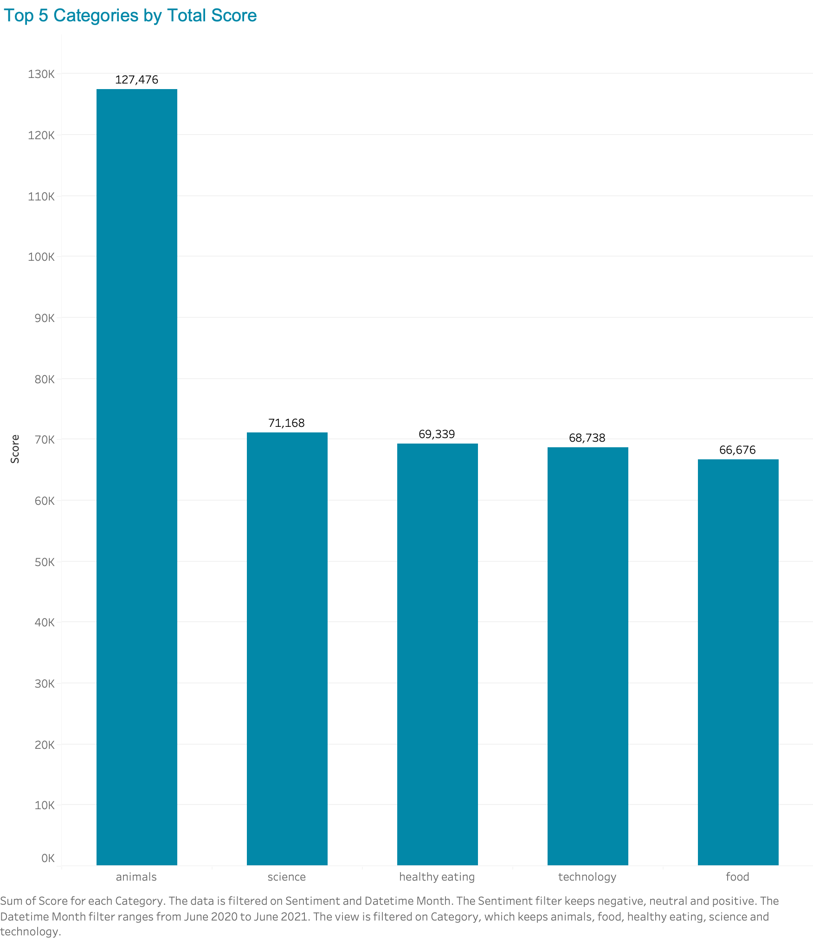
Notes:
Top 5 Categories by Total Score (Bar Chart)
This bar chart highlights the five highest-performing content categories based on their aggregate popularity scores.
Insight: The Animals category leads with a score of 11,958, followed by Food (6,568), Healthy Eating (6,105), Science (5,567), and Technology (5,281). These categories represent the key drivers of engagement on the platform.

Slide 9
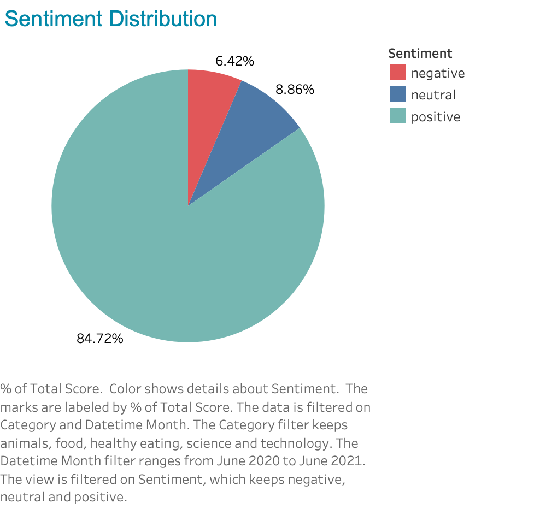
Notes:
Sentiment Distribution (Pie Chart)
This pie chart provides a breakdown of user reactions into positive, neutral, and negative sentiments.
Insight: The majority of reactions (83.83%) are positive, indicating high satisfaction with content. Neutral reactions (10.12%) suggest areas for exploration, while negative reactions (6.05%) pinpoint potential dissatisfaction.

Slide 10
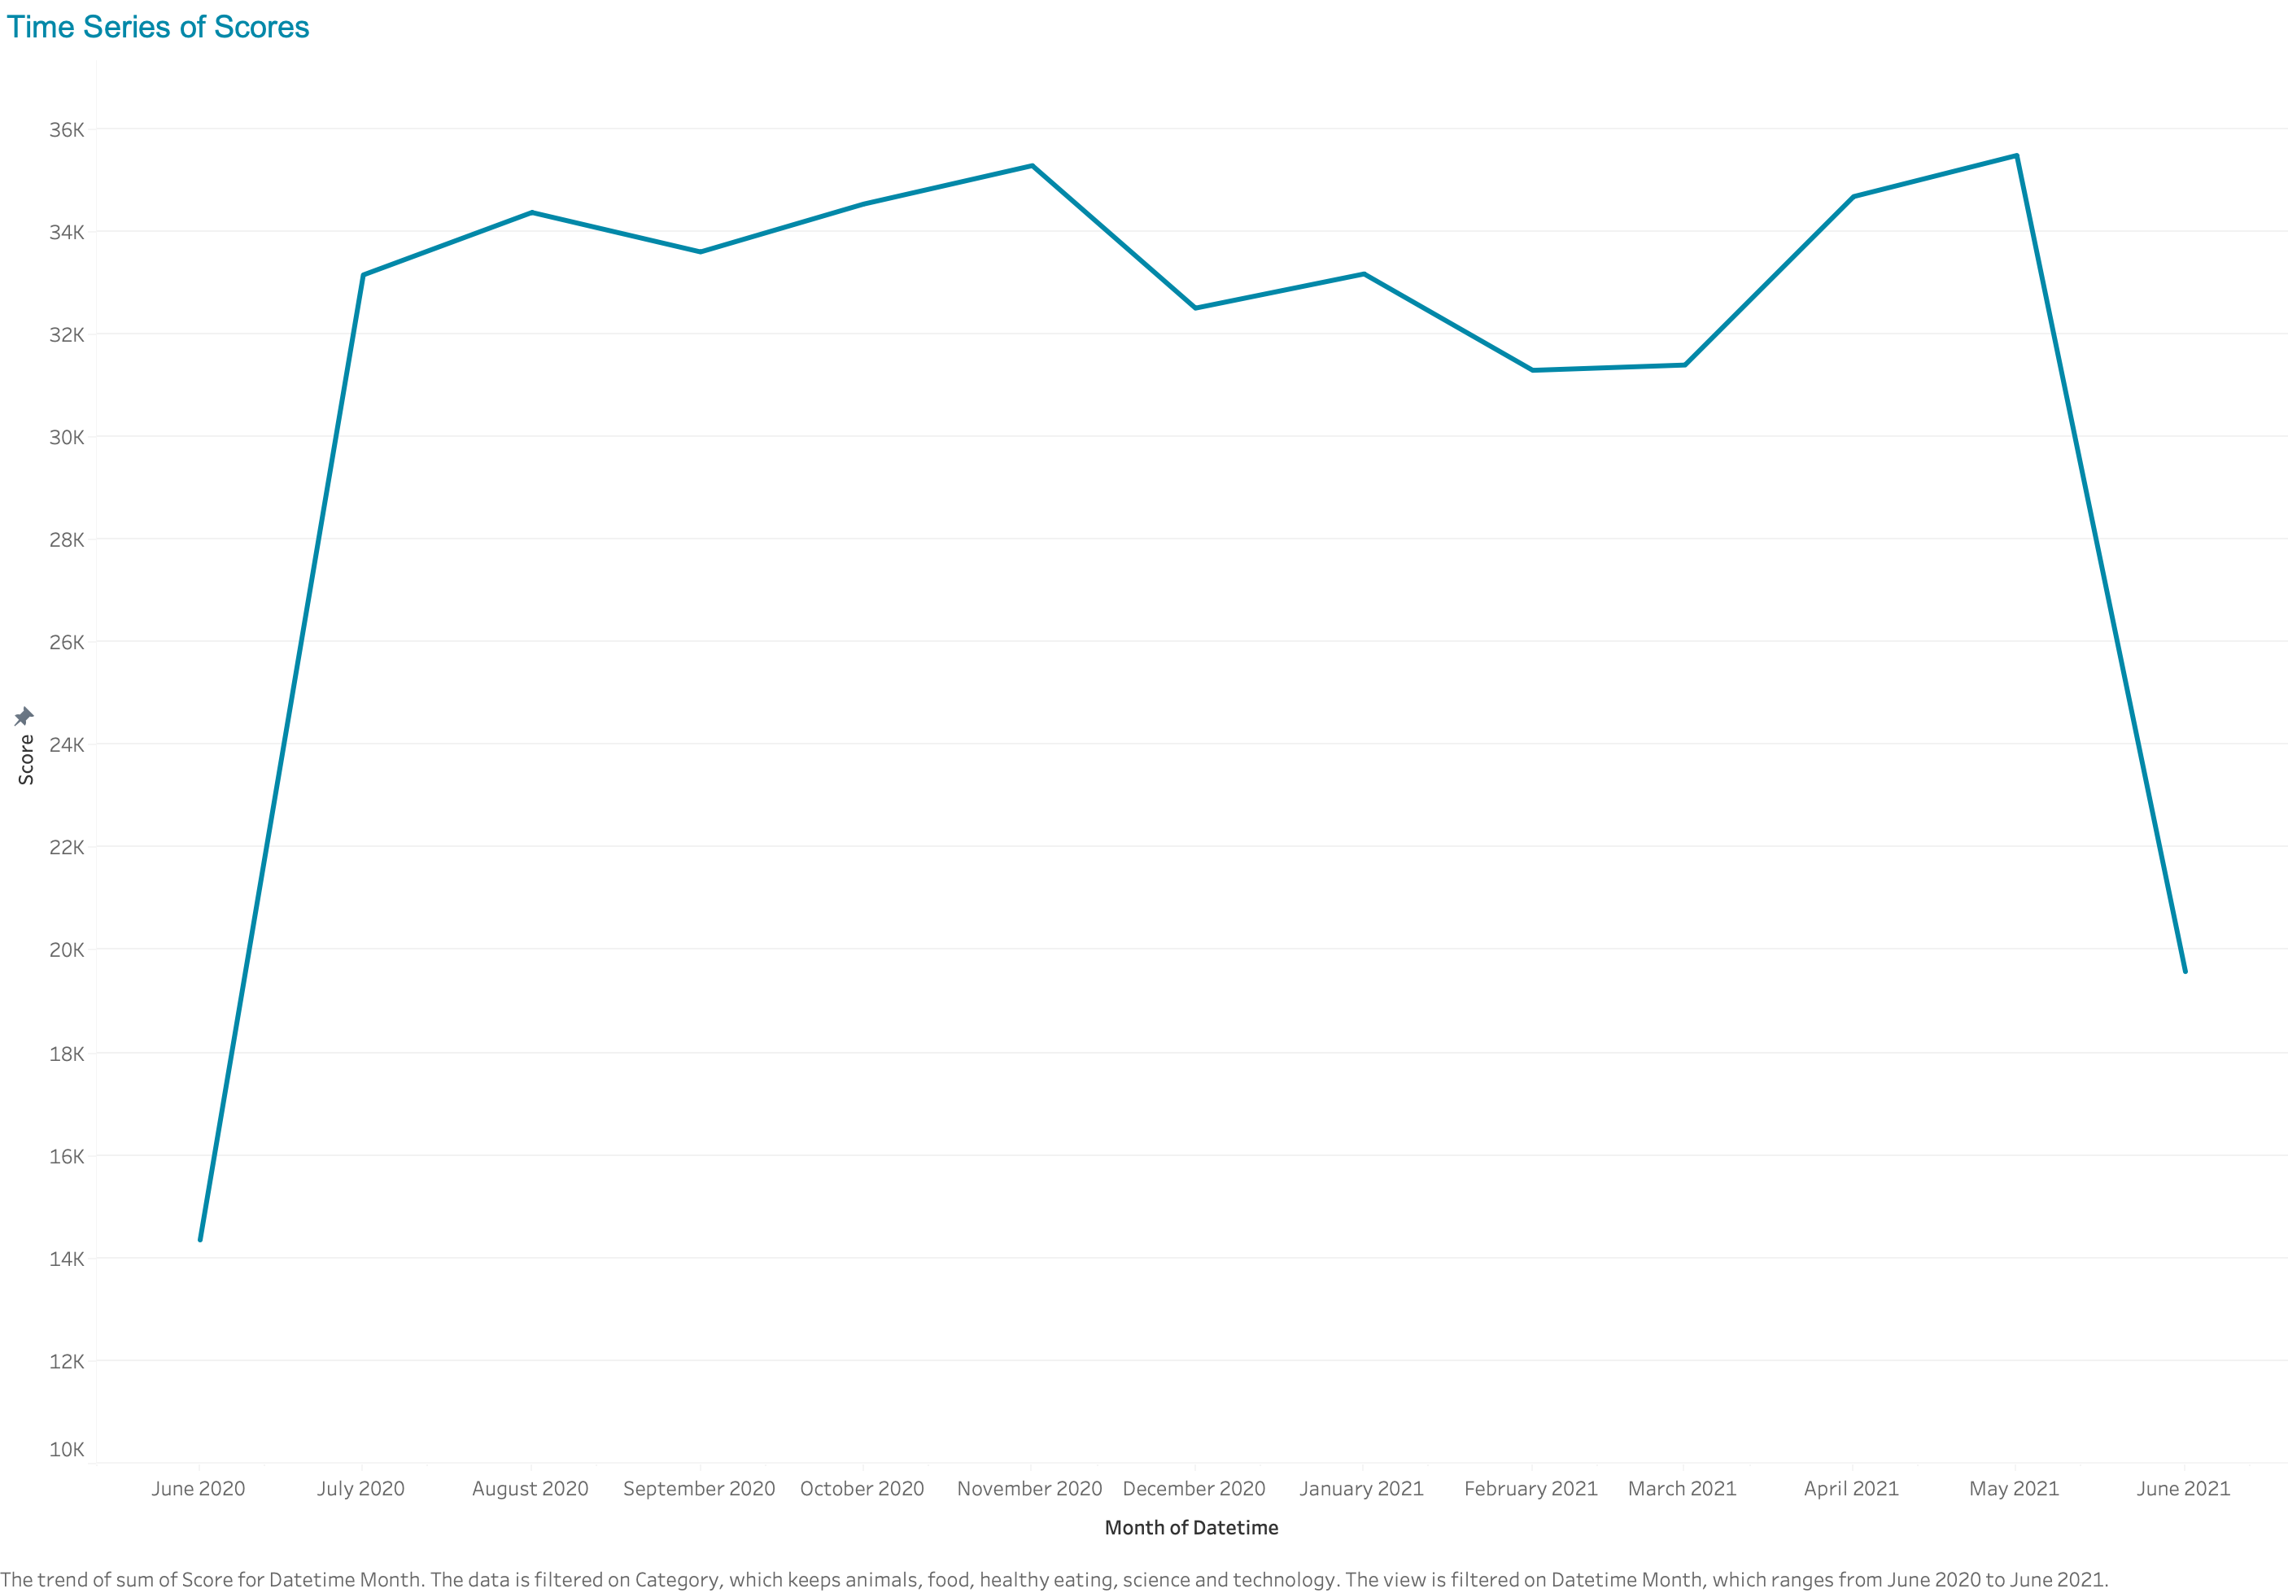
Notes:
Time Series of Scores (Line Chart)
This line chart shows the trend of engagement scores over time, from June 2020 to June 2021.
Insight: Engagement peaked in May 2021, nearing a score of 35,479, and remained relatively stable with minor fluctuations afterward. A notable decline occurred toward June 2021, signaling a potential drop in activity.

Slide 11

ANALYSIS
The analysis revealed that the categories Animals, Food, and Healthy Eating consistently drive the highest engagement, making them critical for SocialBuzz's content strategy.
Summary
Content Strategy
To maintain and grow engagement, SocialBuzz should prioritize content creation in top-performing categories.
Engagement Optimization
The peak engagement period in May 2021 offers valuable insights into what drives user activity.

Slide 12

Thank you!
ANY QUESTIONS?

